Slide 1
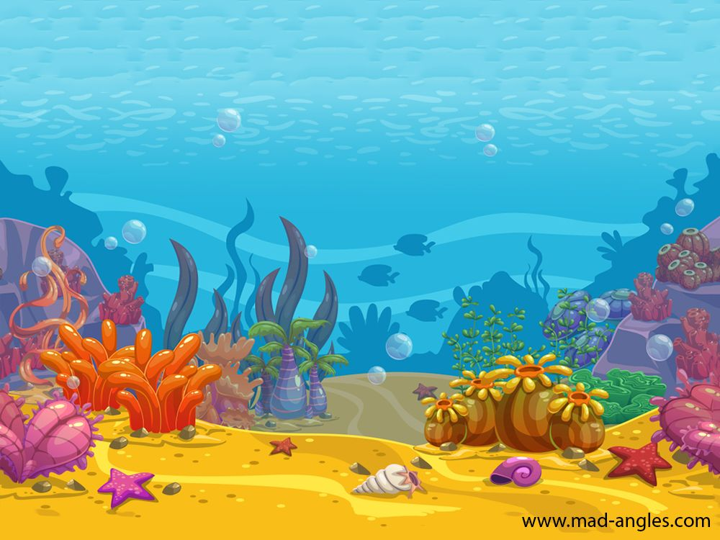
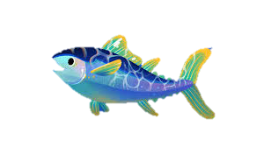
Hi everyone, my name is Nemoe, and I am an Atlantic bluefin tuna, one of the largest fish in the Atlantic Ocean! Let me show you my world!

Slide 2
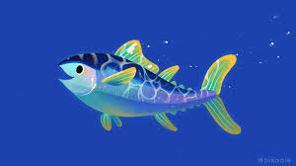
Once upon a time my family and I swam freely in the ocean. There were so many of us! Grandpa Roy, Uncle Yiming and my many other friends... we led such a happy life!
Uncle Yiming
Grand Roy
Ignatius
Rithik

Slide 3
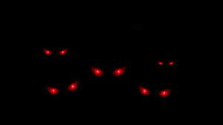
But then...

Slide 4
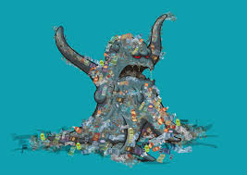
The monsters came….

Slide 5
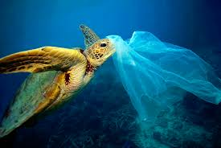
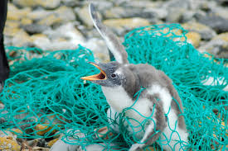
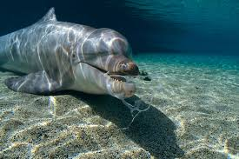
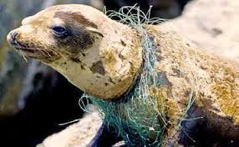
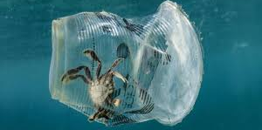
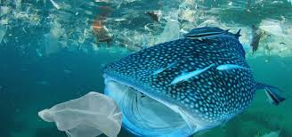
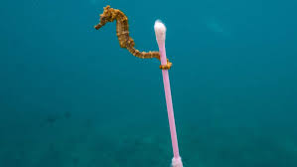
The MONSTERS choked my friends with plastic

Slide 6
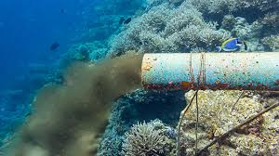
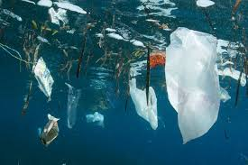
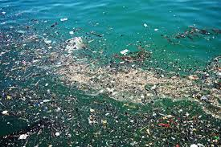
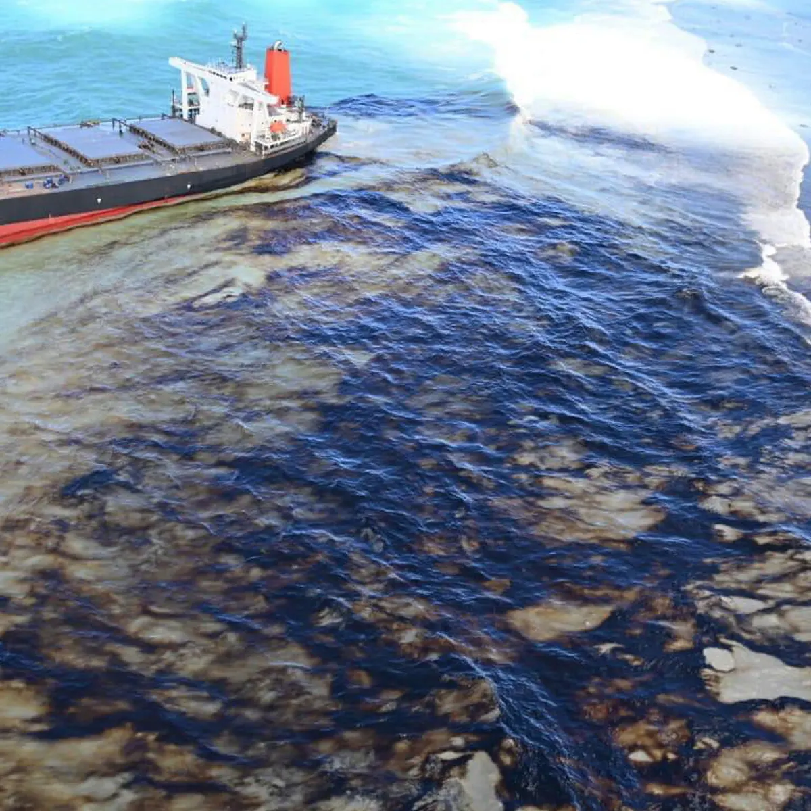
The monsters poisoned my home!

Slide 7
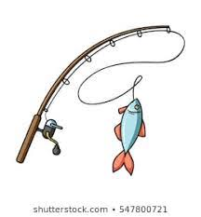
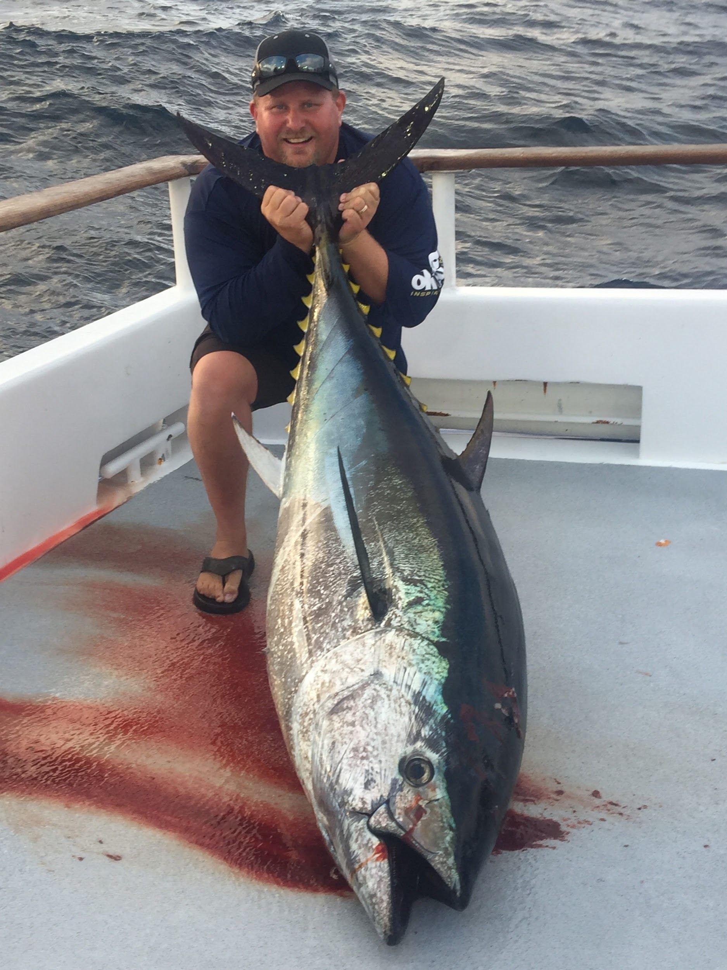
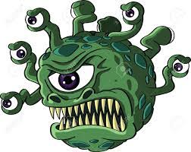
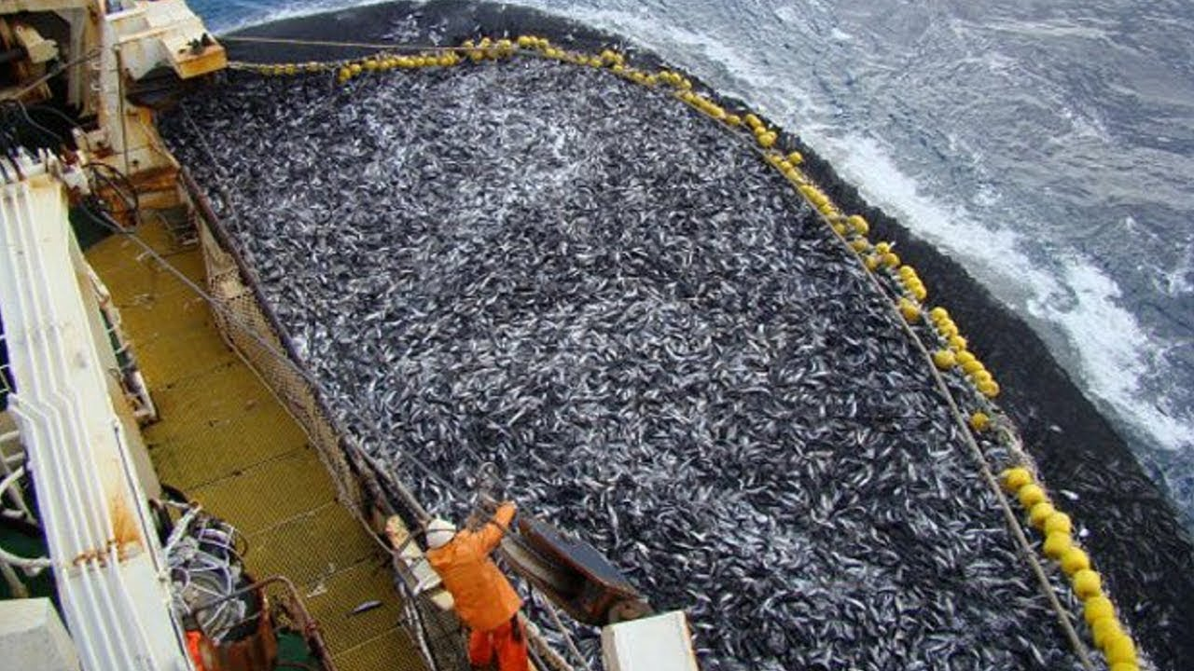
The monsters caught so many of my friends… what for?

Slide 8
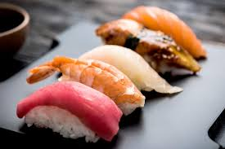
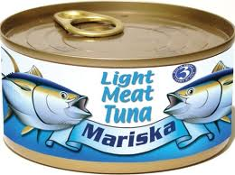
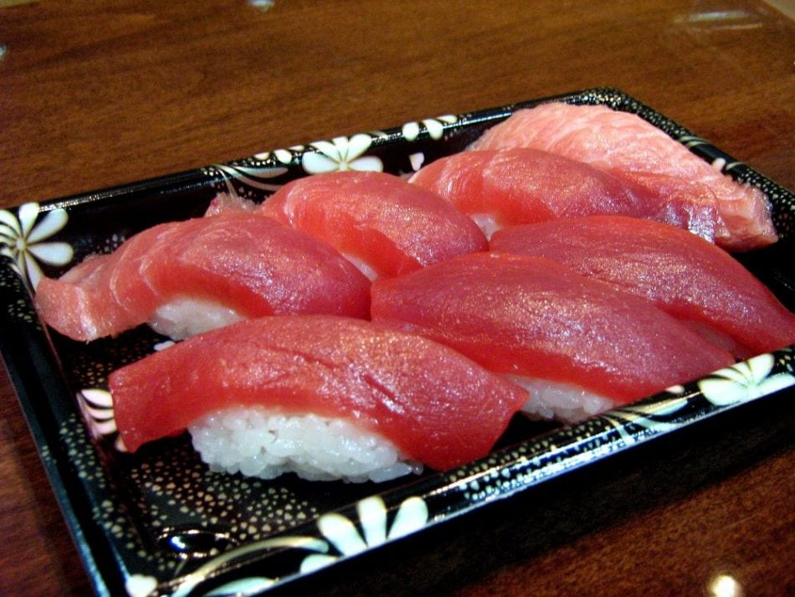
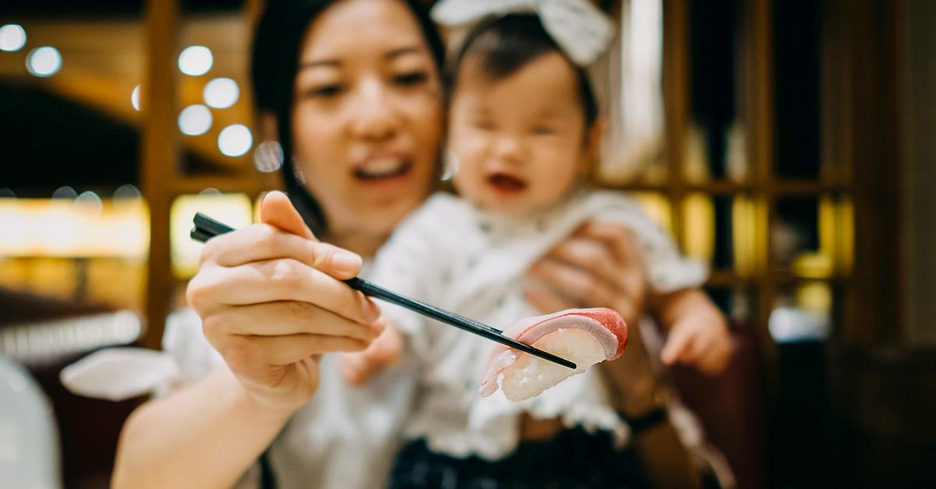
The monsters ate my friends!
YUM!

Slide 9
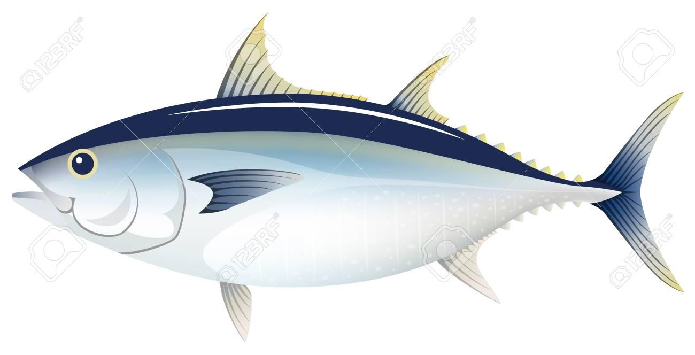
Year by year, my friends get fewer...

Slide 10
and fewer...

Slide 11
and fewer...

Slide 12
until...

Slide 13
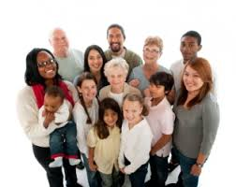
All my friends! Where are they? We, the Atlantic bluefin tuna, are now endangered!

Slide 14
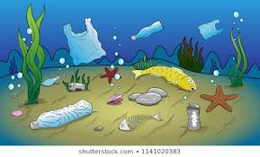
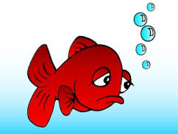
I hope the monsters stop using so much plastic!
I wish the monsters did not waste so much things!
I yearn for the day where the monsters will stop hunting my friends and go away!

Slide 15
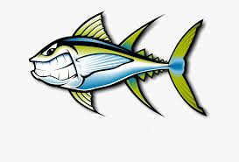
Who are these monsters?

Slide 16
We are.

